Slide 1
Nerd’s Gallery: CD For Paintings
Jiang Shuyu Liu Ziqian Zhang Ming Zhang Jiacan
Group 5
Our homepage: https://minghust.github.io

Slide 2
Outline
The data we use
The workflow we go through
Insights we get form painting communities
Analysis through algorithms

Slide 3
Starting Point
What is the relationship of different styles of paintings?

Slide 4
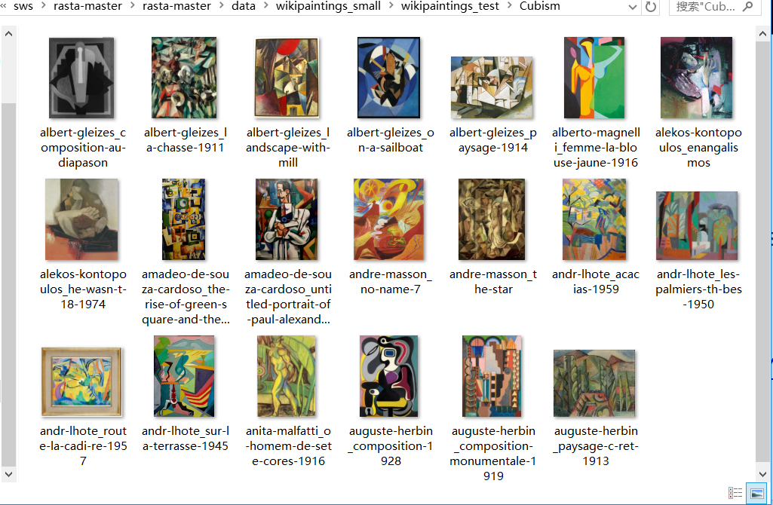
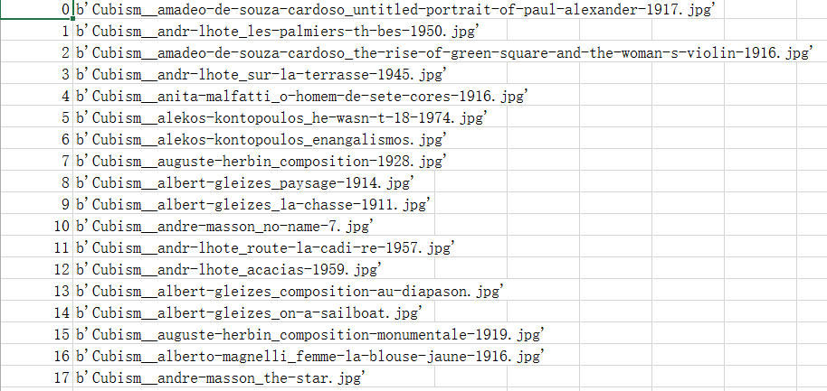
Dataset
12 styles (Impressionism,
Cubism, etc.)
20 paintings in each style,
labeled with its name and style.
From WikiArt
(https://www.wikiart.org)

Slide 5
Working Loop
Verify
Dataset
Analyze
Results
Apply
CD
Algorithm
Your text

Slide 6
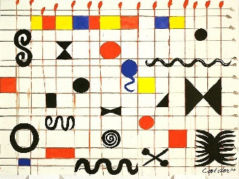
Workflow(1)
Pre-trained
CNN
Feature Vector
The feature vector has a size of (12,1).
The value X_{i} indicates the probability with which this painting is predicted to belong to i^{th} style.
For each pair of paints, We compute the Euler distance between their feature vectors as the dissimilarity between them.
Euler distance:

Slide 7
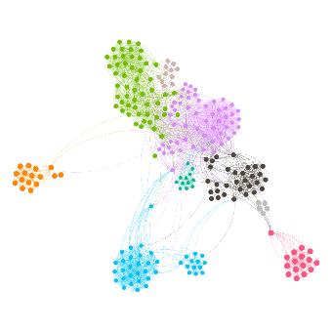
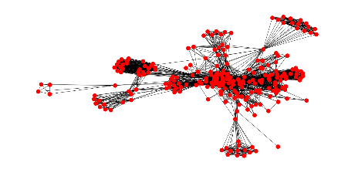
Workflow(2)
Deeper
Analysis
Dissimilarity Matrix
Graph
Communities
Girven-Newman
When forming dissimilarity matrix, we set a threshold manually and let all values greater than the threshold be 0.
We use Python library NetworkX to generate graphs.
We reuse Prof. Kal’s code to apply Girvan-Newman algorithm and visualize the results.
Also, we try Markov Clustering and CPM, using a project on GitHub and NetworkX respectively.

Slide 8
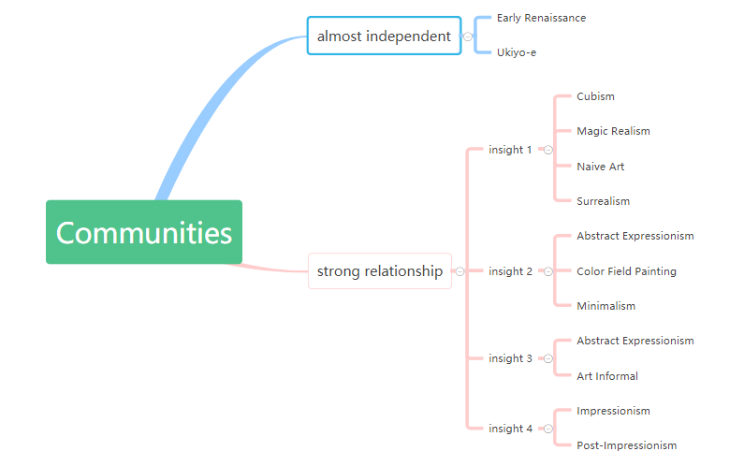
Girvan-Newman Algorithm
Results
We got communities for different styles and plotted them.
Label: <style-id>, it means the node is the idth painting of the style.
Community types:
Some styles are almost separated from others like Early Renaissance
and Ukiyo-e.
Some styles are closed to others, such as Impressionism, Post Impressionism and Color Field painting, Minimalism and so on.
Here’s the relationship between styles we found.
Here’s the Global sight of communities with Pals.

Slide 9
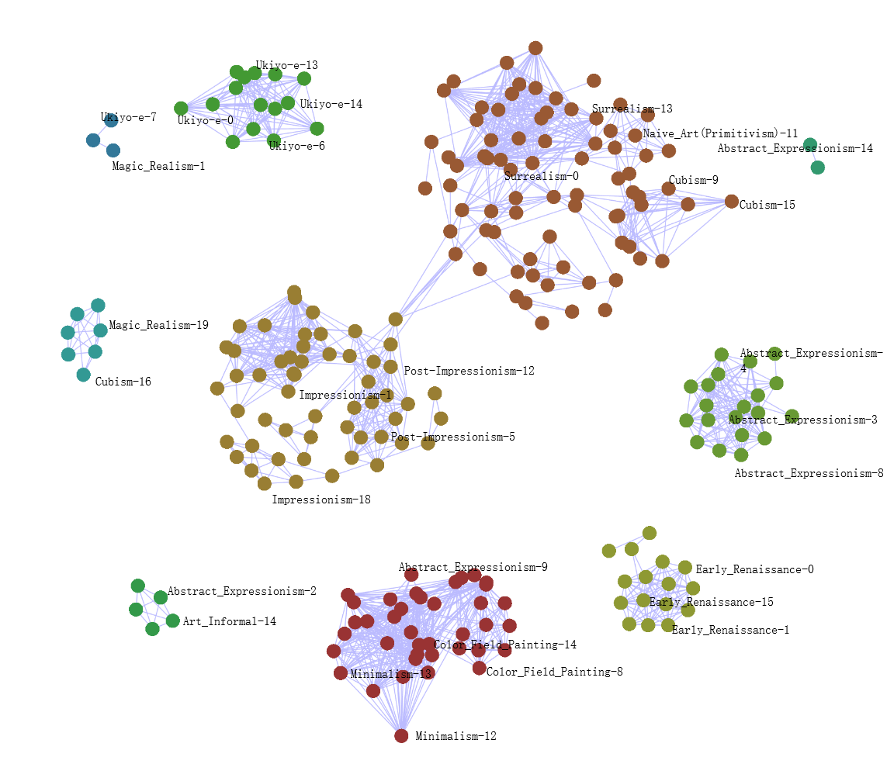

Slide 10
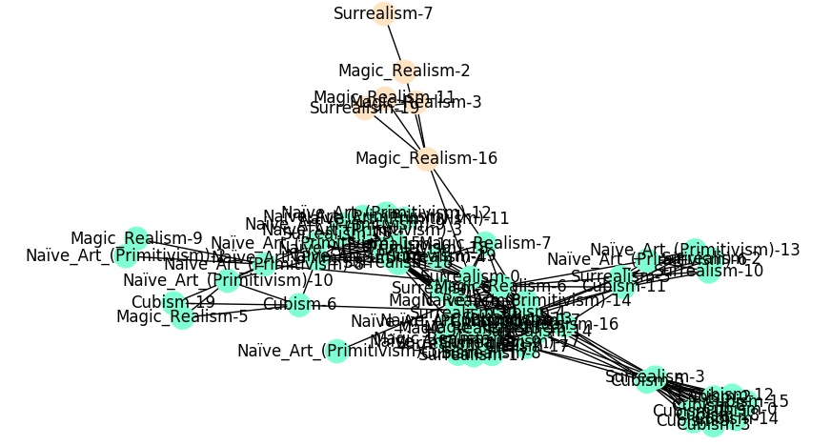
GN Algorithm Analysis
Analysis 1
The communities of Cubism, Magic Realism, Naive Art, Surrealism is closed to each other from the result.
CNN recognition accuracy for the 4 painting styles is 81.25%.
Naive Art and Cubism seem reperated, but they are generally connected to others.

Slide 11
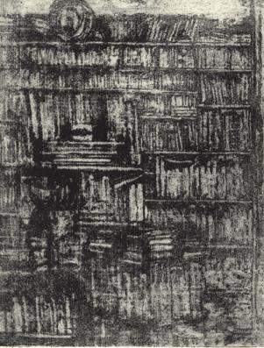
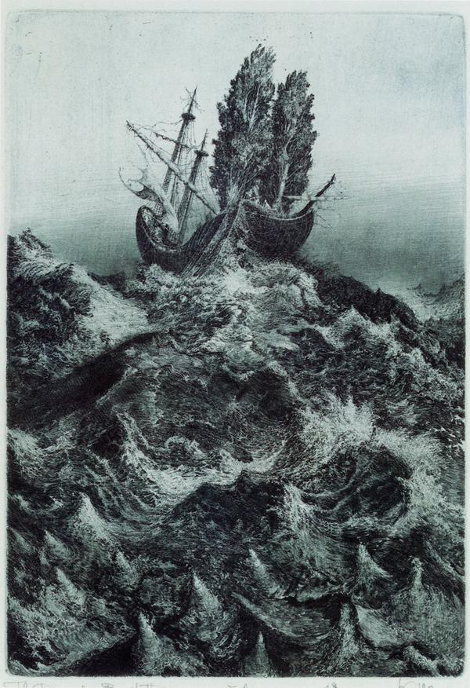
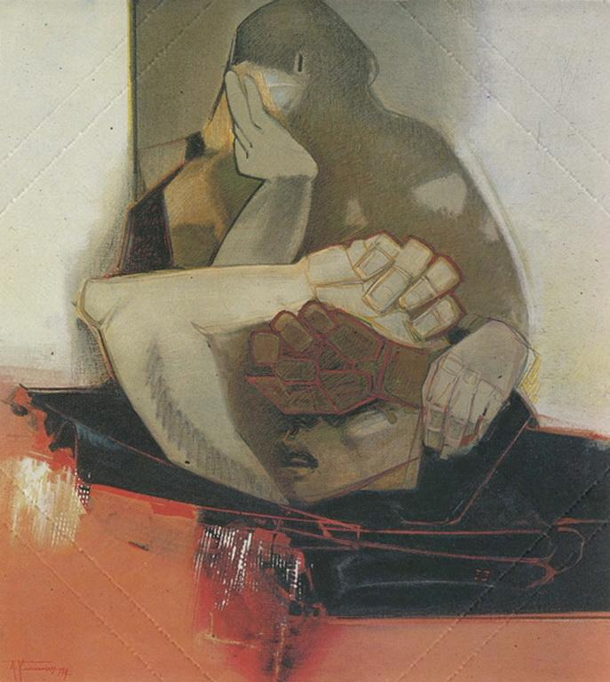
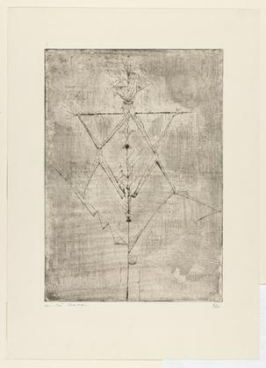
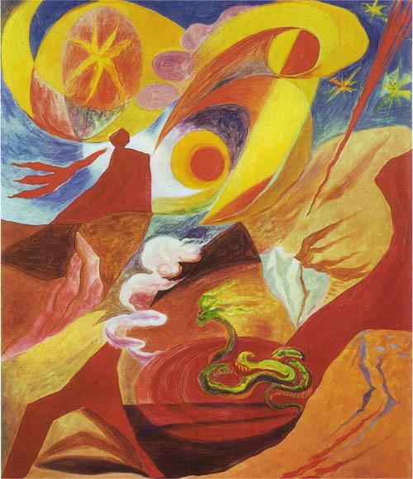
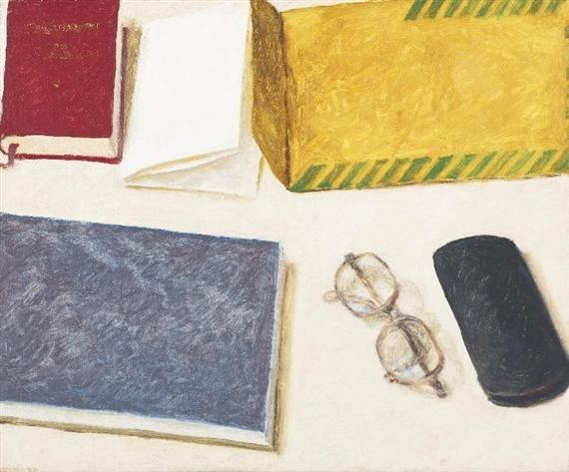
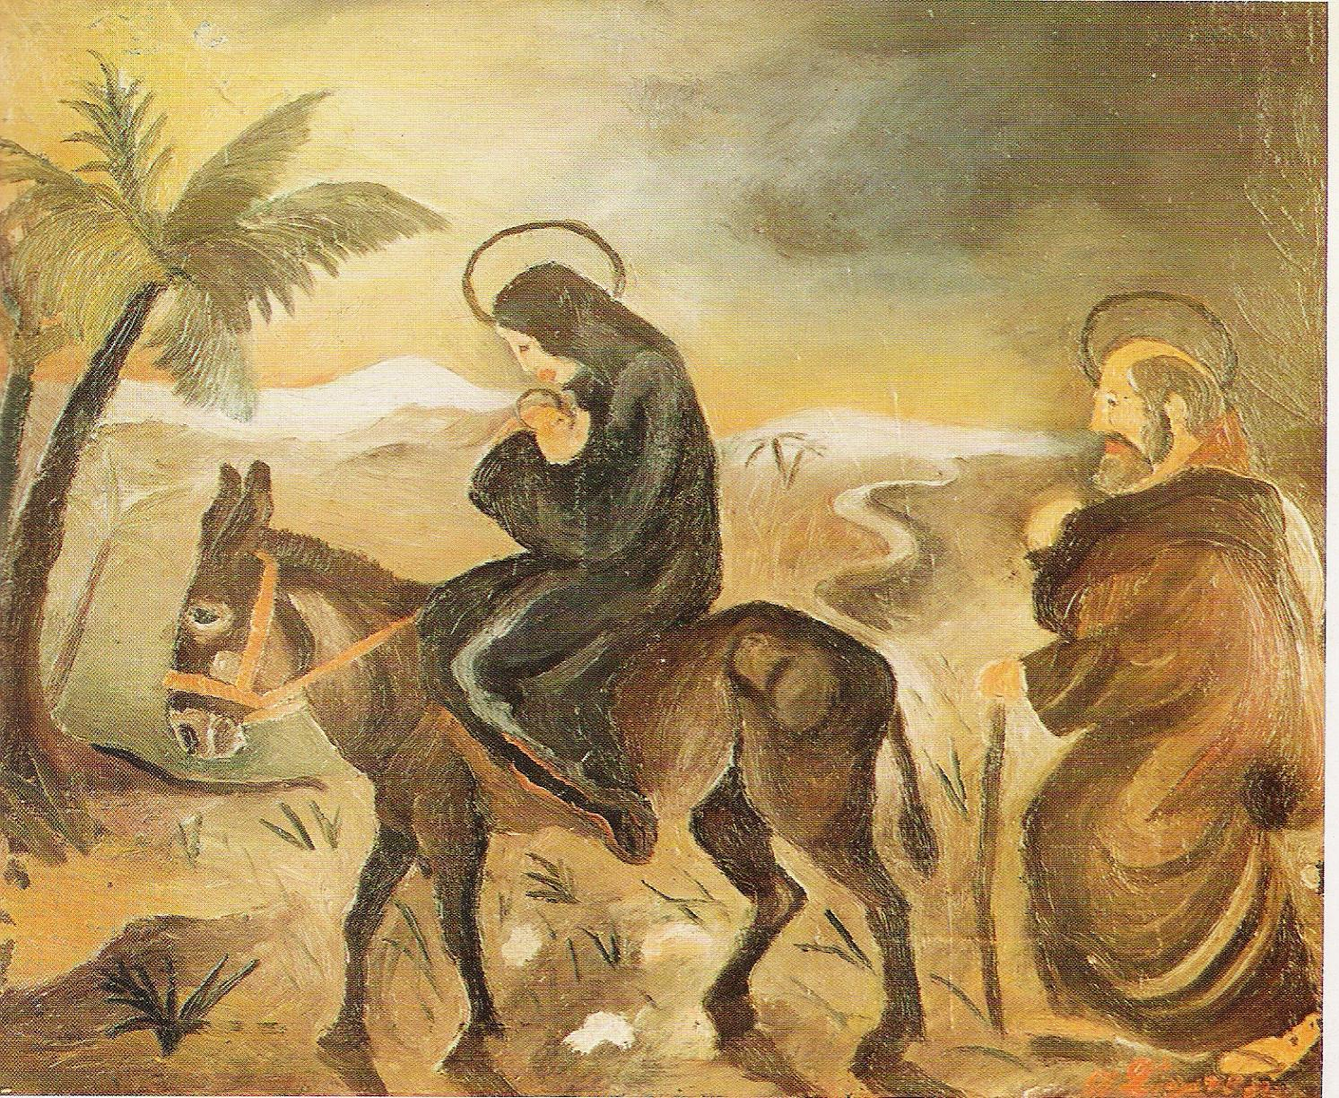
GN Algorithm Analysis
Analysis 1
There are many connections between
the 4 style paintings, Some examples here.
a) "Magic realism-3", "Surrealism-19"
b) "Surrealism-3", "Cubism-5"
c) "Cubism-11", "Magic realism-6", "Naive art-16"
We can get some commonality between
them and we have found some reference
to prove this.
a) Surrealism is a further development of Collage, Cubism,
and Dada. (infoplease.com)
b) Both Surrealism and Magic Realism use a mixture of realism
and fantastic elements. (Mia Feigelson Gallery introduction)
c) Important influences on Magic Realism came from
the Naive art of Henri Rousseau and the
Metaphysical works of Giorgio de Chirico.
(tendreams.org/Magic-art.htm)
Magic realism-3
Surrealism-19
Cubism-5
Surrealism-3
Cubism-11
Magic realism-6
Naive art-16

Slide 12
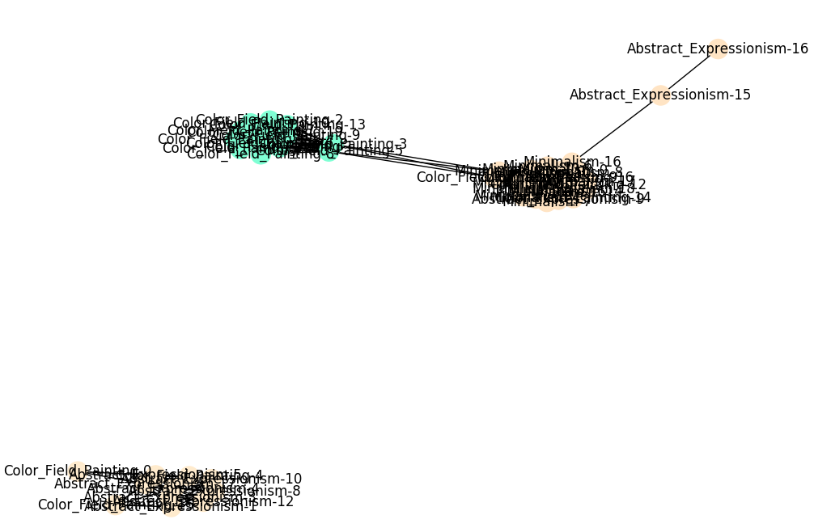
GN Algorithm Analysis
Analysis 2
Color Field painting, Minimalism are different styles while they have
something in common with Abstract Expressionism.
CNN recognition accuracy is 90.0%.

Slide 13
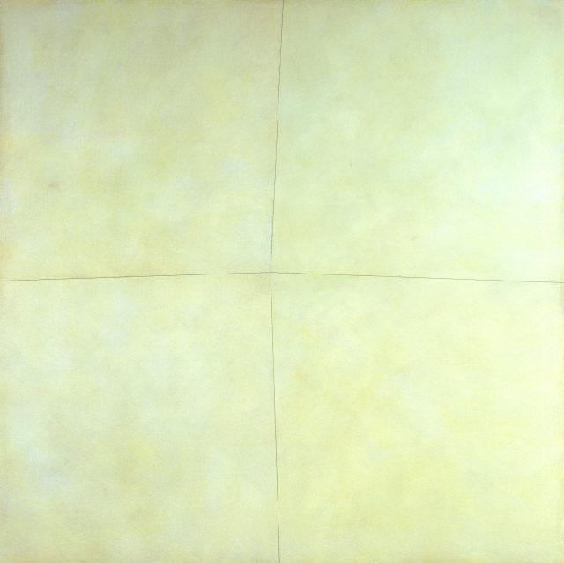
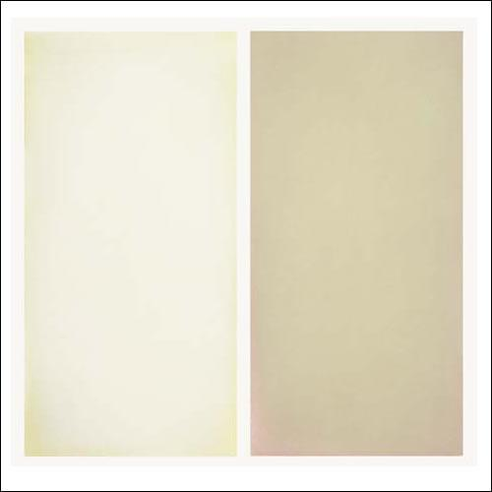
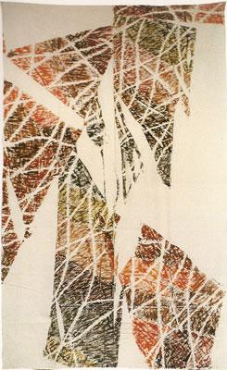
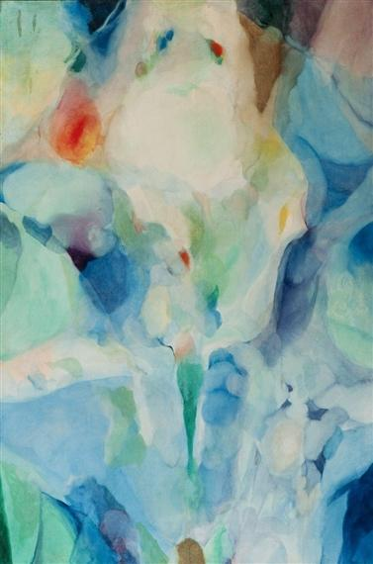
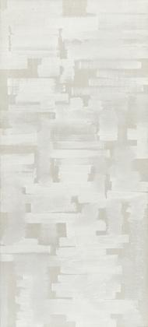
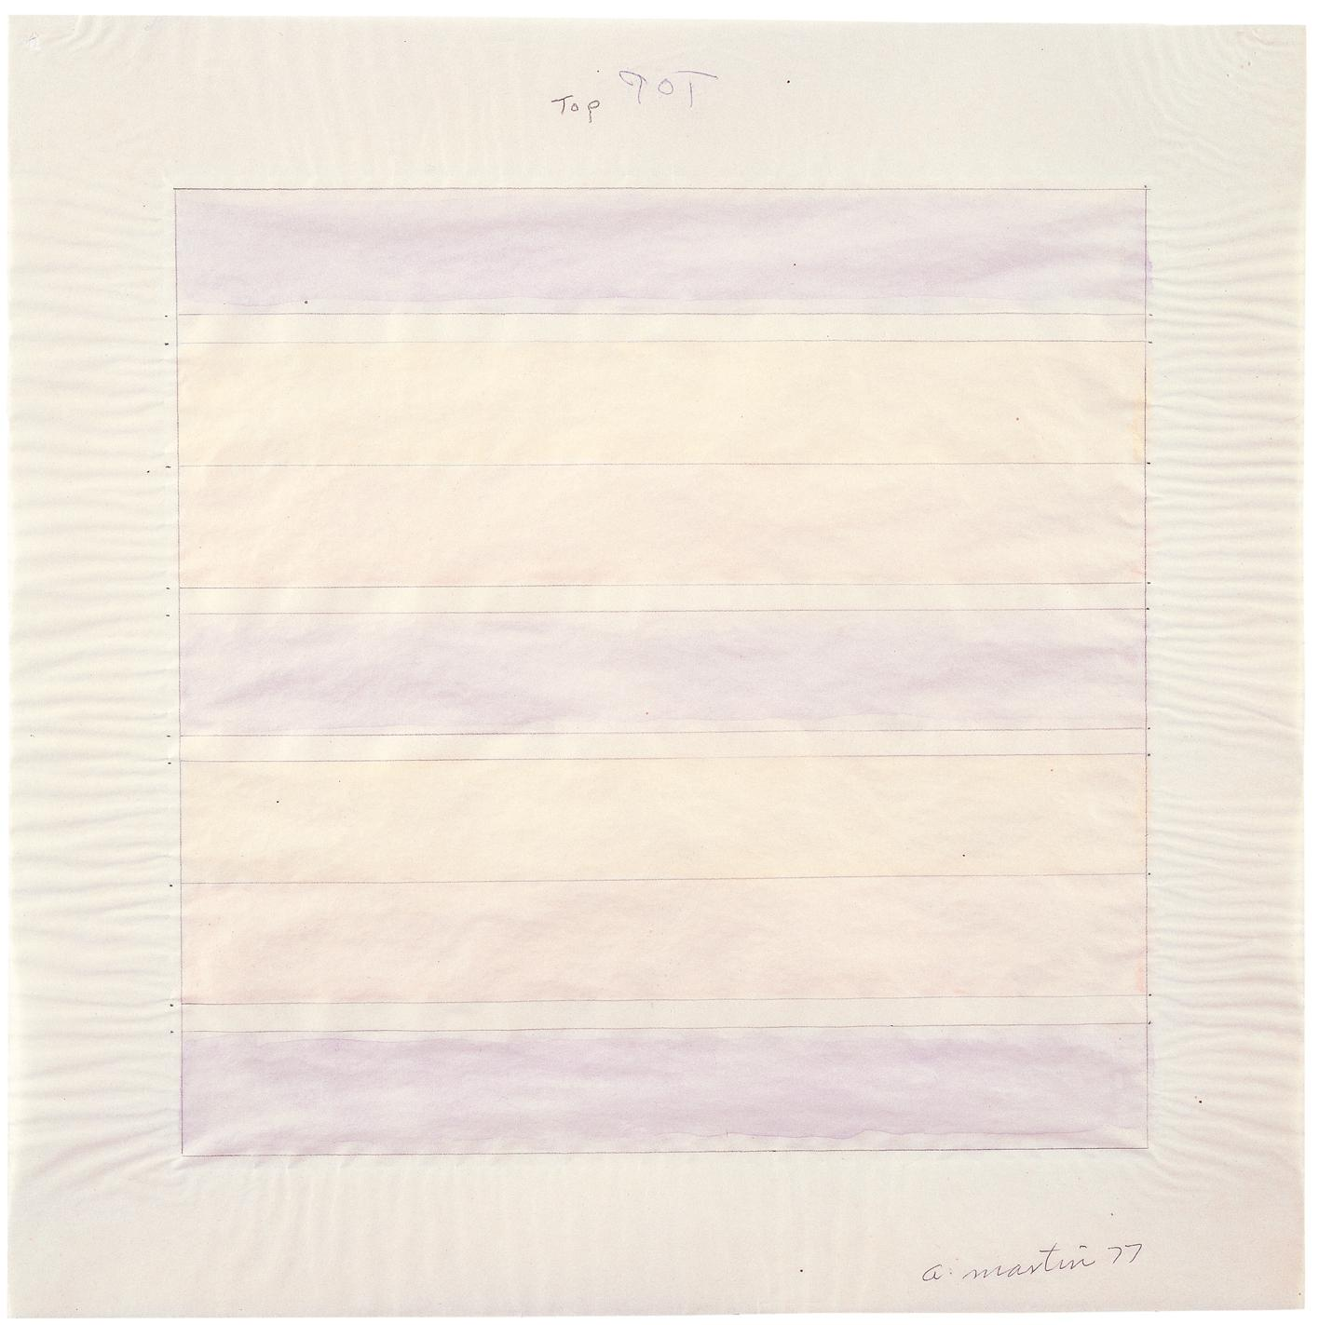
GN Algorithm Analysis
Analysis 2
Color Field painting and Minimalism have
two paintings in the same style.
"Minimalism-15" and "Color Field-13" are both in light color.
Abstract Expressionism has connections
with Color Field painting and Minimalism.
a) "Color Field -7", "abstract-expressionism-14"
b) "Minimalism-6", "abstract-expressionism-8"
We have found some reference and known
that both Minimalism and Color Field are
developed from Abstract Expressionism.
a) Color Field painting is a style of abstract painting. It was
inspired by European modernism and closely related to
Abstract Expressionism. (wikipedia)
b) Morris Louis's painting Where 1960, was a major innovation
that moved Abstract Expressionist painting forward in a new direction toward Color Field and Minimalism. (wikipedia)
Minimalism-15
Color Field-13
Color Field-7
Abstract Expressionism-14
Abstract Expressionism-8
Minimalism-6

Slide 14
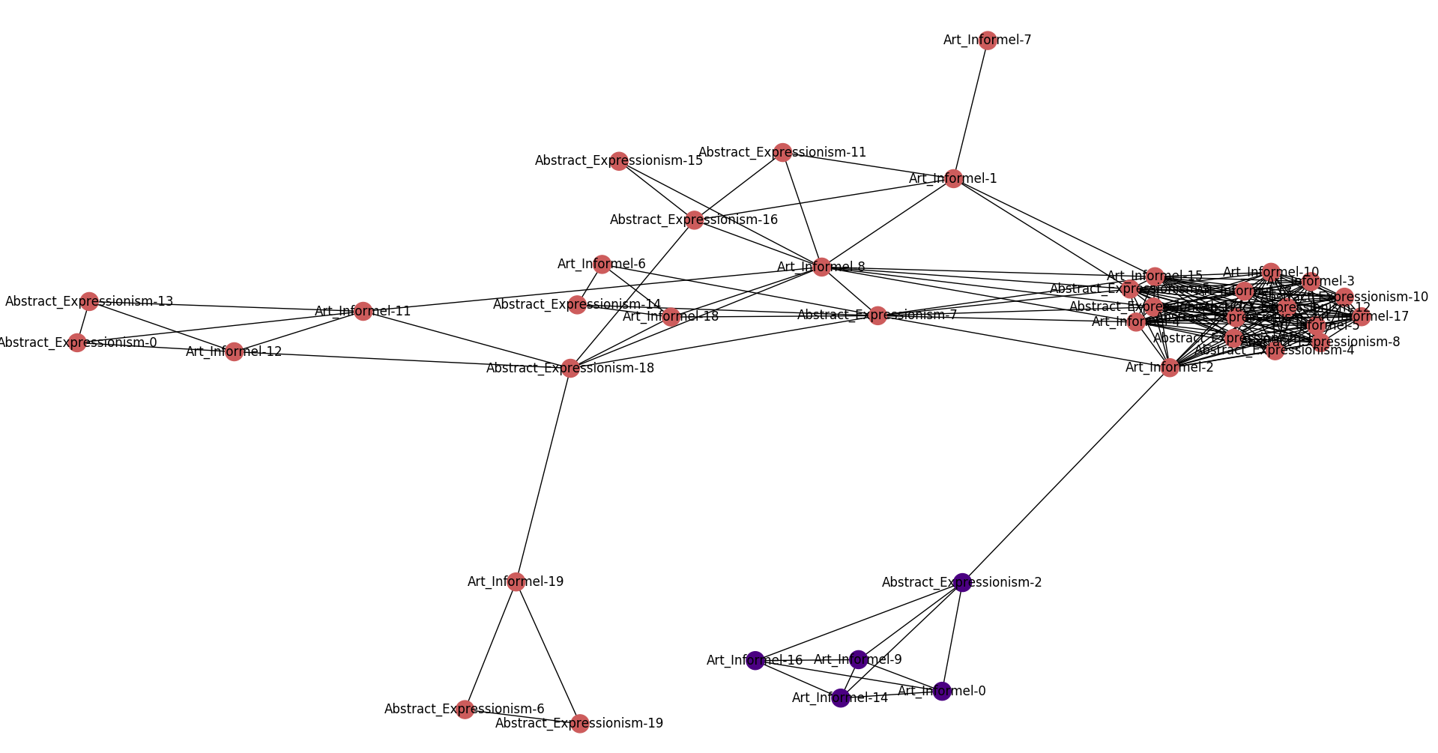
GN Algorithm Analysis
Analysis 3
Abstract Expressionism and Art Informal have strong connections.
CNN recognition accuracy is 82.5%. It means that the CNN doesn't
distinguish the two styles very well.

Slide 15
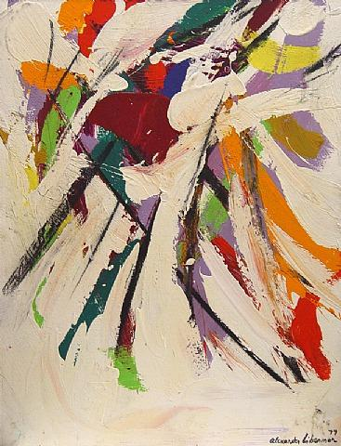
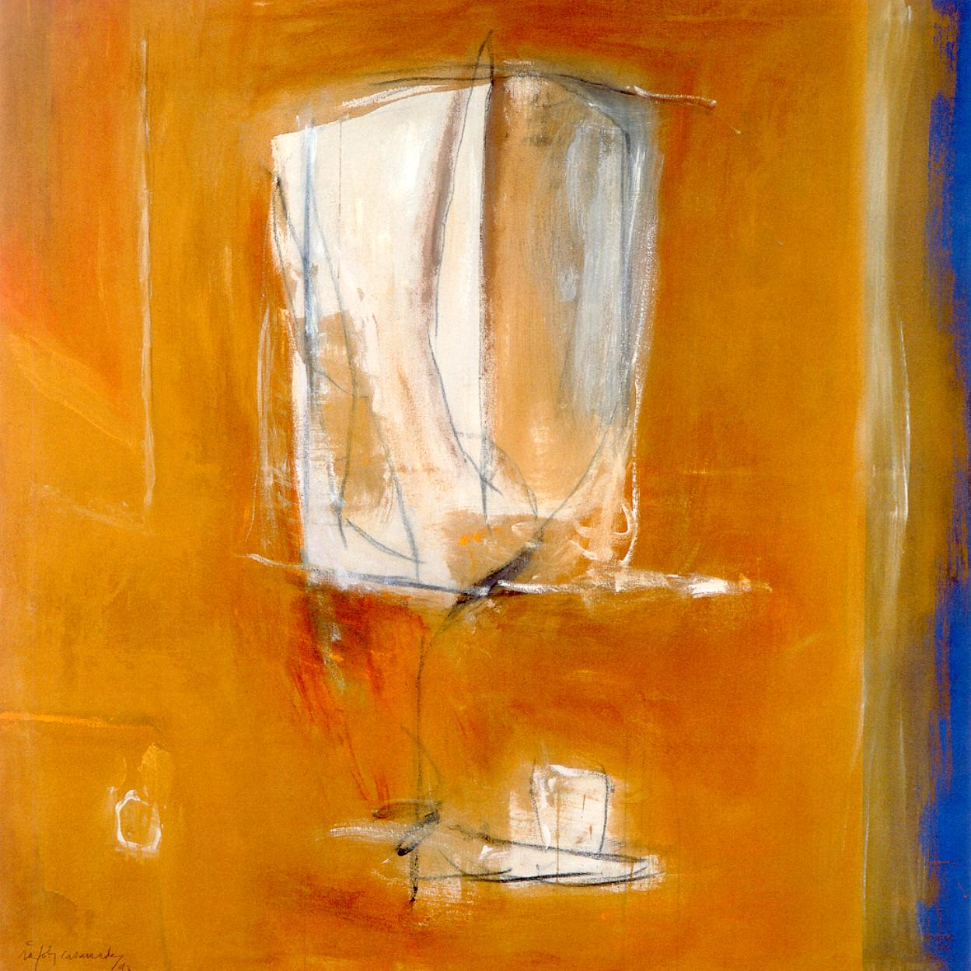
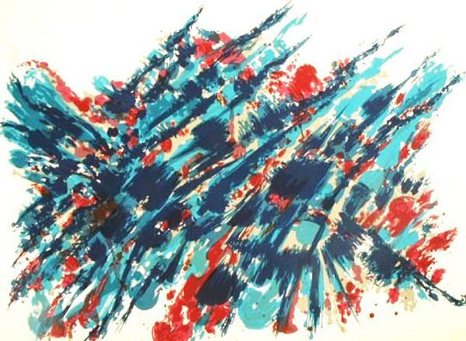
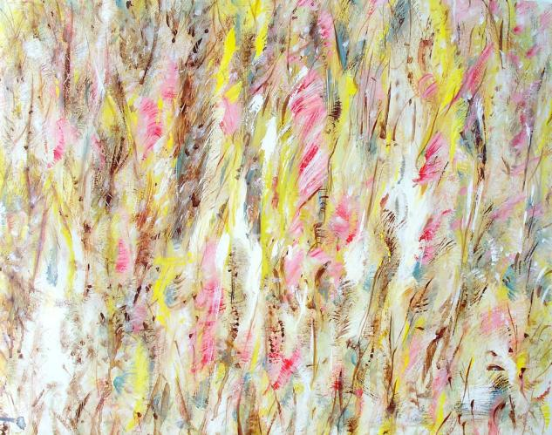
GN Algorithm Analysis
Analysis 3
Difference between Abstract Expressionism
and Art Informal is small. Examples here.
a) "Abstract Expressionism-12", "Art Informal-5"
b) "Abstract Expressionism-19", "Art Informal-16"
The two styles are quite similar from the pictures.
There also are evidence to prove this.
The artists associated with Art Informel are sometimes called
the international equivalents of the Abstract Expressionists.
(ideelart.com)
Abstract Expressionism-12
Art Informal-5
Art Informal-16
Abstract Expressionism-19

Slide 16
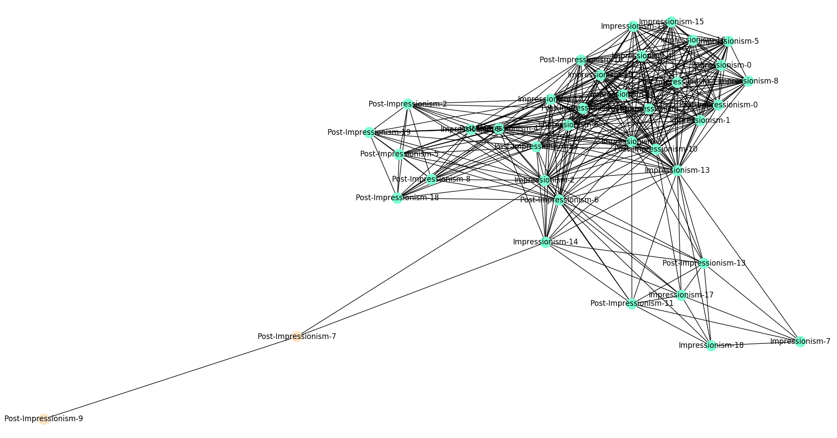
GN Algorithm Analysis
Analysis 4
Impressionism and Post-Impressionism also have strong connections.
CNN recognition accuracy is 90.0%.

Slide 17
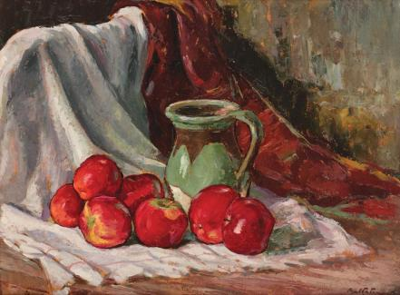
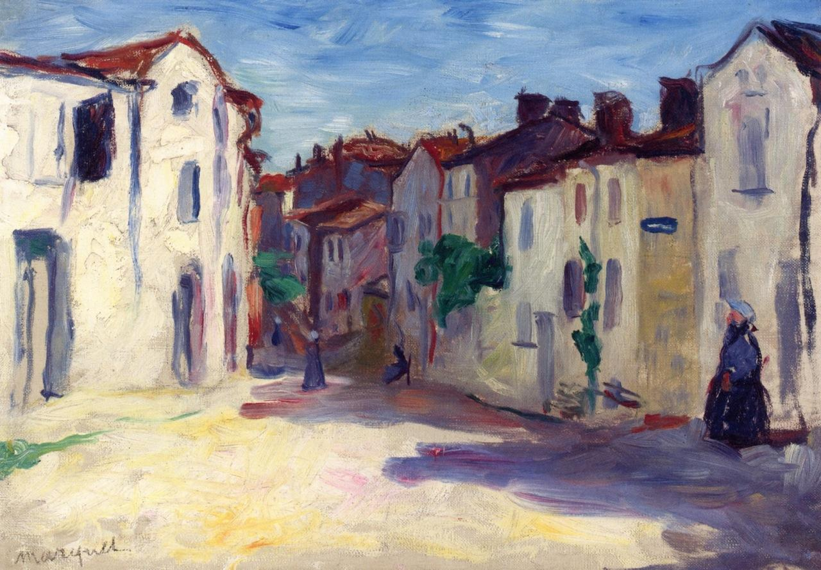
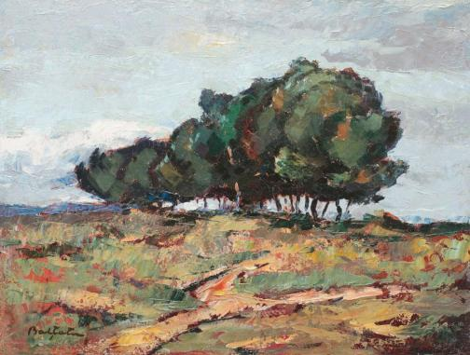
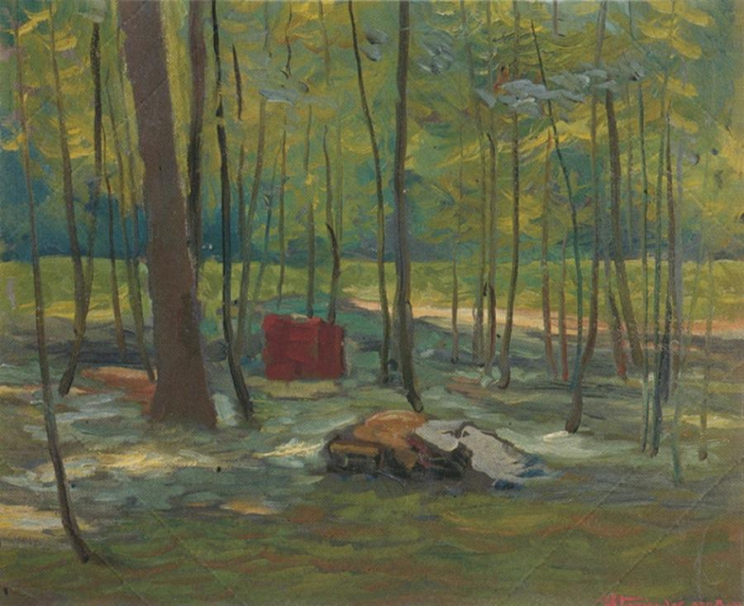
GN Algorithm Analysis
Analysis 4
Impressionism and Post-Impressionism are
developed from France in 19th centuray, so
it's reasonable that their communities to be
together. Here are the examples.
a) "Abstract Expressionism-12", "Art Informal-5"
b) "Abstract Expressionism-19", "Art Informal-16"
History of the Impressionism and Post
Impressionsim can be found.
Both Impressionism and Post-Impressionism refer to
influential artistic movements arising in late 19th-century France.
(ideelart.com)
Impressionism-20
Post-Impressionism-14
Impresssionism-5
Post-Impressionism-16

Slide 18
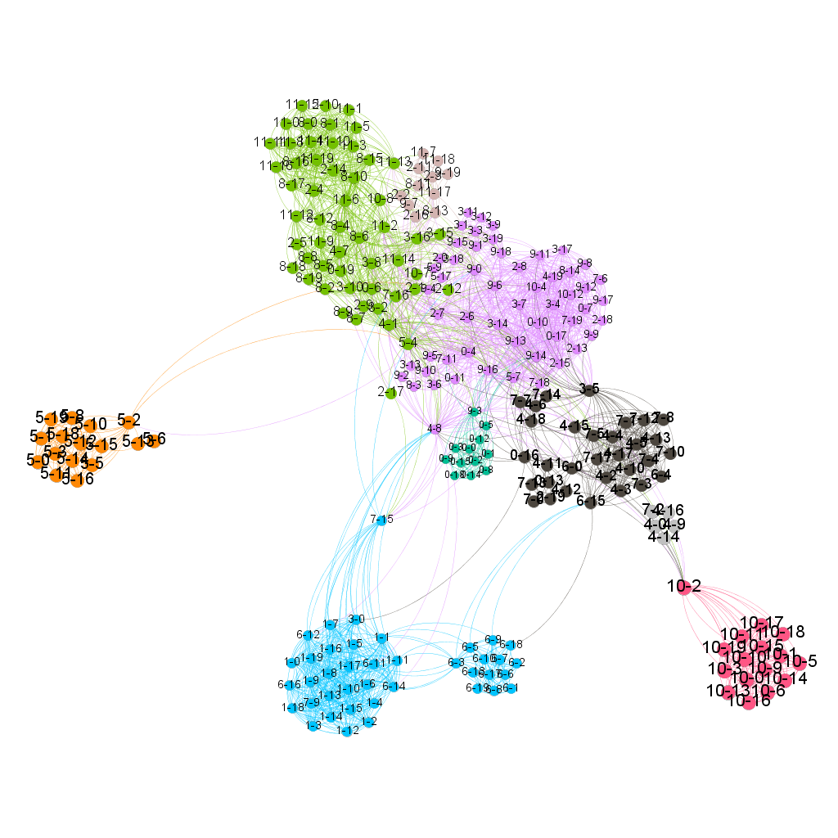
How about the CPM
Using CPM to detect communities is a good way to find group-group relations ,as it’s shown in the picture. However, In clustered areas, the boundaries between communities and communities have also become blurred.
Modularity=0.66

Slide 19
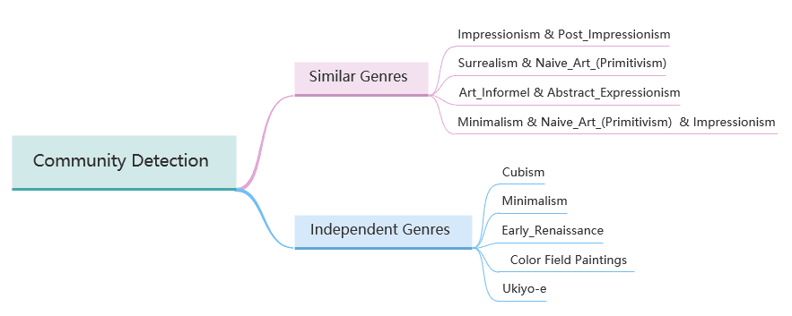
Results from CPM

Slide 20
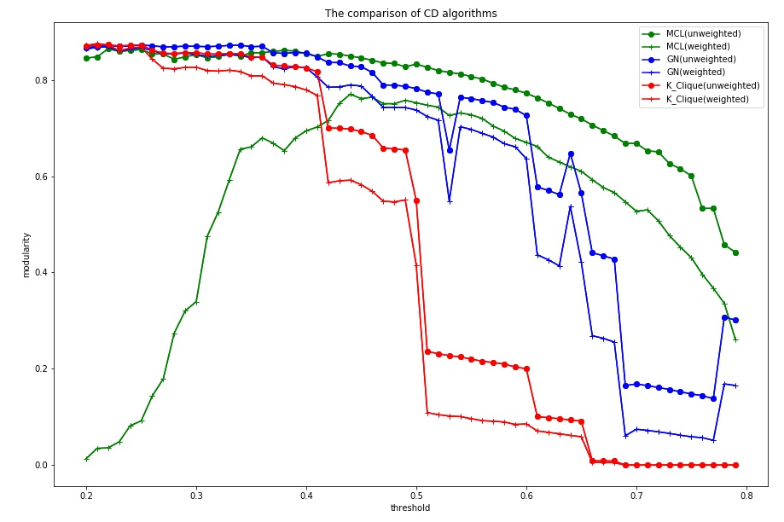
Analysis through Algorithms(1)
Networks with high modularity have dense connections between the nodes within modules but sparse connections between nodes in different modules.

Slide 21
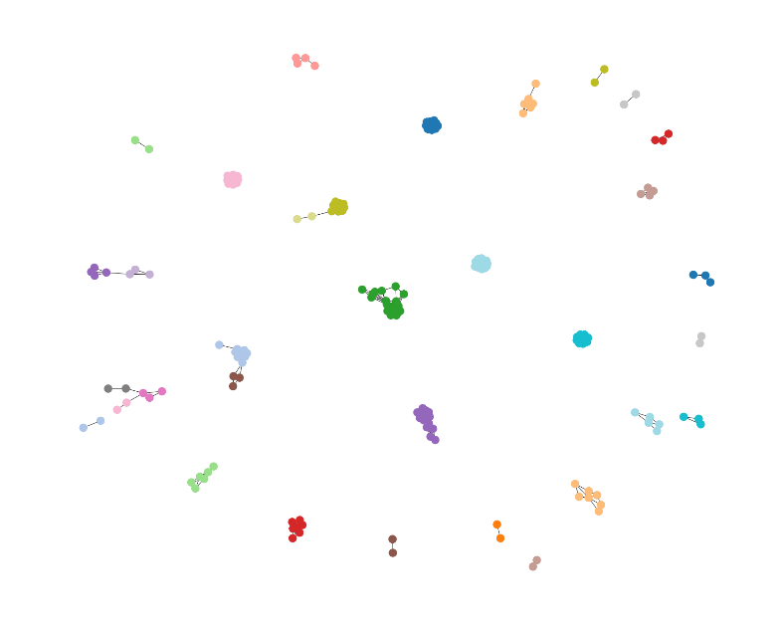
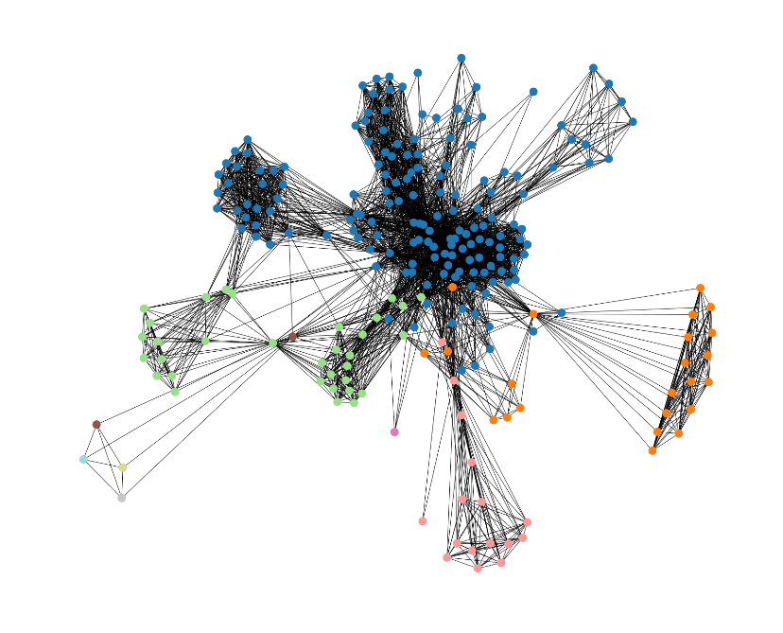
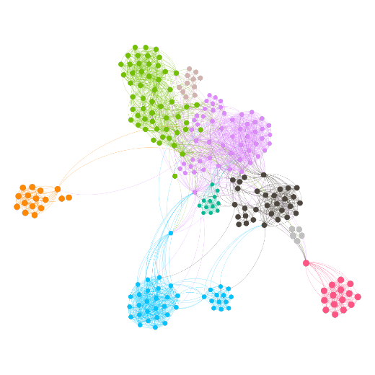
Analysis through Algorithms(2)
Communities with different modularity
Modularity=0.86
Modularity=0.66
Modularity=0.15
Based on our experiments, modularity between 0.6 and 0.8 is the most suitable case in our project.

Slide 22
Analysis through Algorithms(3)
All three algorithms perform better on unweighted graphs than weighted graphs.
Most algorithms get very high modularity with low threshold, because we cut so many edges that only some core communities can survive.
MCL is more stable when the threshold changes.
And Girvan-Newman seems to have less stability than CPM.

Slide 23
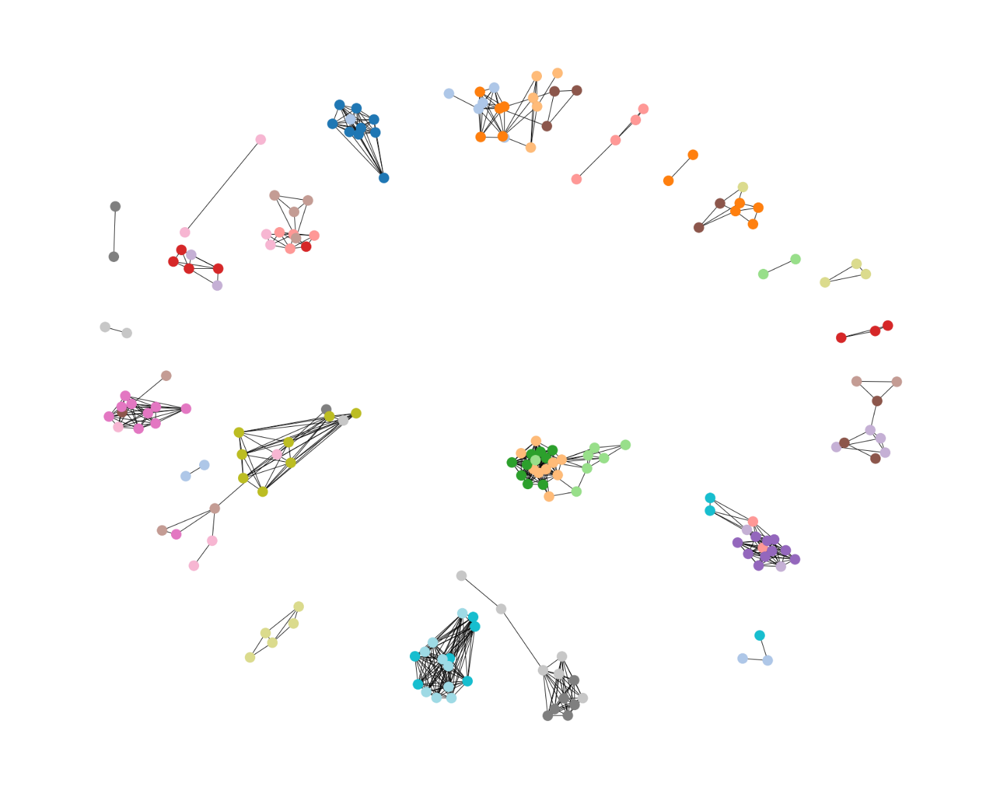
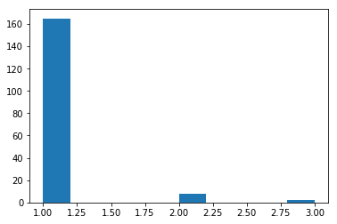
Analysis through Algorithms(4)
What happened to MCL(weighted) when threshold<=0.4?
There are 240 paintings, but they are divided into 175 clusters! And the largest
cluster only has 3 nodes.
There are so many one-node clusters that the modularity is reduced.

Slide 24
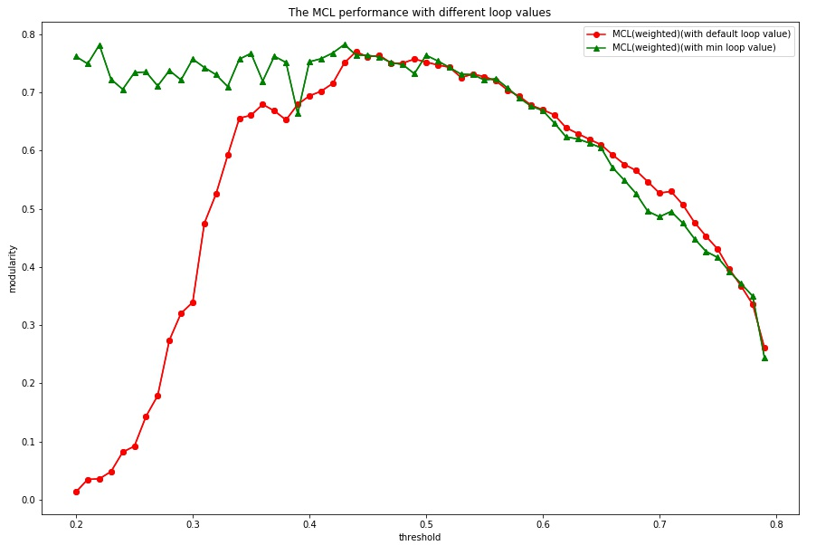
Analysis through Algorithms(5)
What if we decrease loop value manually?
It acts like other algorithms!

Slide 25
Conclusions & Lessons
Conclusions
Most of the relationships we find by the communities can be validated by the painting’s style development history and real genres. It shows that the results of our analysis are good and reasonable.
The deep learning tools is helpful to do more further work, and the CNN’s recognition accuracy of styles can be improved.
Lessons
We can using giant dataset to assist in painting art research through our project.
Cooperation of a team is very important, everyone's work is an indispensable part.

